Slide 1
Low Level / Classical Vision

Slide 2
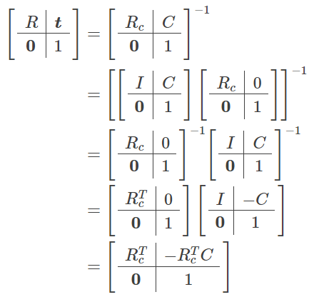
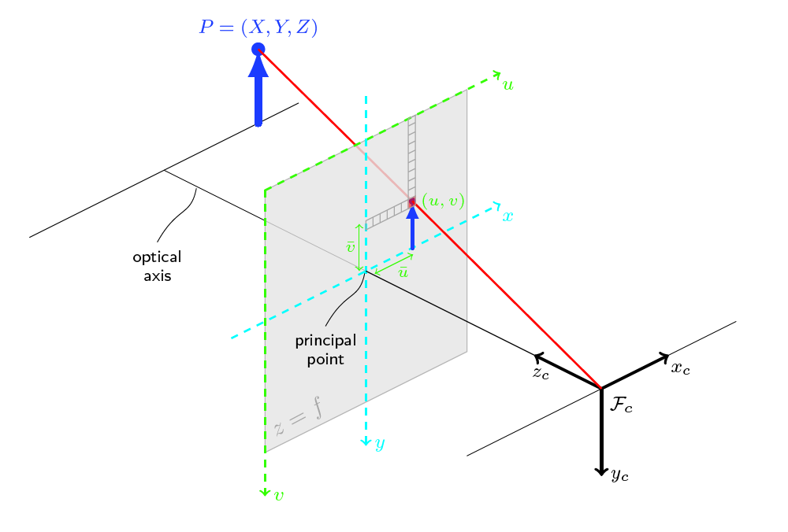
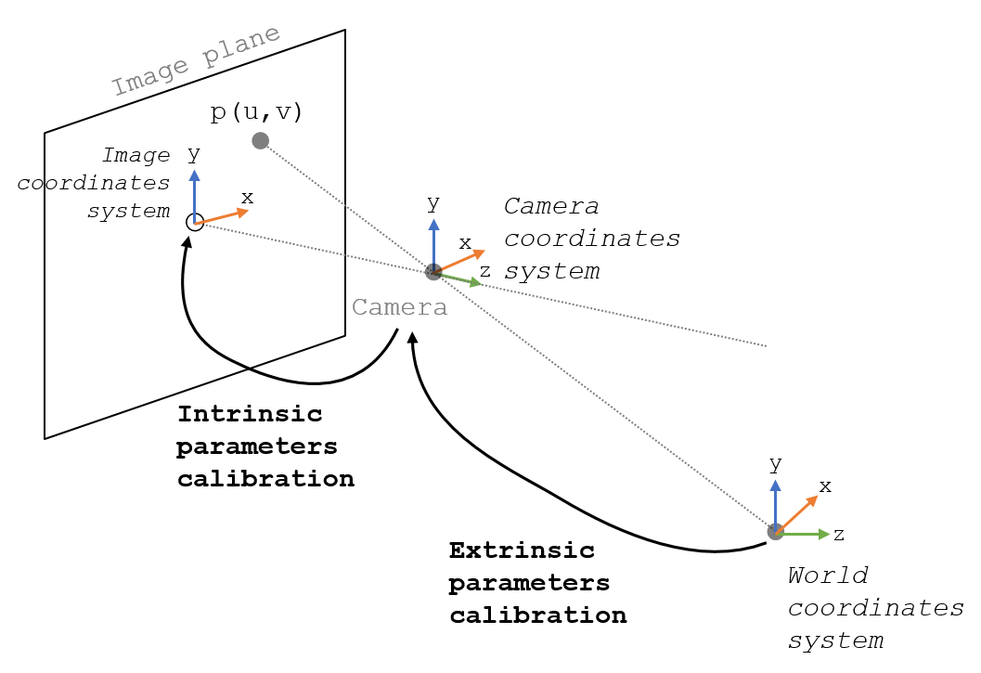
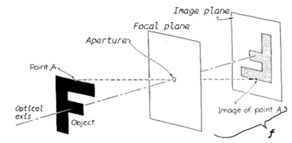

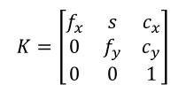
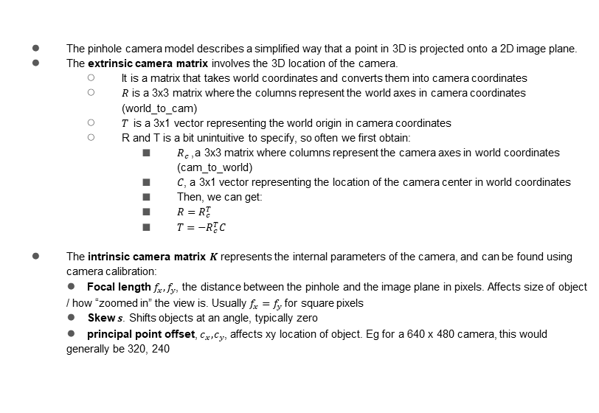
Explain/draw out a sketch of the pinhole camera model.
The pinhole camera model describes a simplified way that a point in 3D is projected onto a 2D image plane.
The extrinsic camera matrix involves the 3D location of the camera.
It is a matrix that takes world coordinates and converts them into camera coordinates
$R$ is a 3x3 matrix where the columns represent the world axes in camera coordinates (world_to_cam)
$T$ is a 3x1 vector representing the world origin in camera coordinates
R and T is a bit unintuitive to specify, so often we first obtain:
$R_{c}$, a 3x3 matrix where columns represent the camera axes in world coordinates (cam_to_world)
$C$, a 3x1 vector representing the location of the camera center in world coordinates
Then, we can get:
${R=R}_{c}^{T}$
$T=−R_{c}^{T}C$
The intrinsic camera matrix $K$ represents the internal parameters of the camera, and can be found using camera calibration:
Focal length $f_{x},f_{y}$, the distance between the pinhole and the image plane in pixels. Affects size of object / how “zoomed in” the view is. Usually $f_{x}=f_{y}$ for square pixels
Skew $s$. Shifts objects at an angle, typically zero
principal point offset, $c_{x},c_{y}$, affects xy location of object. Eg for a 640 x 480 camera, this would generally be 320, 240
$$\left[R | t\right]={\left[\begin{matrix}R_{3×3} & T_{3×1} \\ 0_{1×3} & 1\end{matrix}\right]}_{4×4}$$
$$K=\left[\begin{matrix}f_{x} & s & c_{x} \\ 0 & f_{y} & c_{y} \\ 0 & 0 & 1\end{matrix}\right]$$
Low level / classical vision
Notes:
https://en.wikipedia.org/wiki/Camera_resectioning
https://ksimek.github.io/2012/08/22/extrinsic/
https://www.imatest.com/support/docs/pre-5-2/geometric-calibration-deprecated/projective-camera/
https://web.stanford.edu/class/cs231a/course_notes/01-camera-models.pdf
https://stackoverflow.com/questions/38494485/camera-coordinate-to-pixel-coordinate-opencv

Slide 3
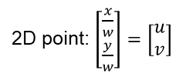
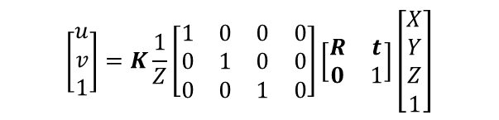
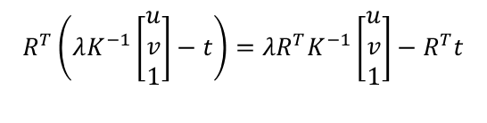

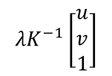
What are the equations to turn a 3D point to 2D, and a 2D point to a 3D ray?
3D point -> 2D point (Projection)
2D point -> 3D Ray (Unprojection)
$$\left[\begin{matrix}u \\ v \\ 1\end{matrix}\right]=K\frac{1}{Z}\left[\begin{matrix}1 & 0 & 0 & 0 \\ 0 & 1 & 0 & 0 \\ 0 & 0 & 1 & 0\end{matrix}\right]\left[\begin{matrix}R & t \\ 0 & 1\end{matrix}\right]\left[\begin{matrix}X \\ Y \\ Z \\ 1\end{matrix}\right]$$
$$λK^{−1}\left[\begin{matrix}u \\ v \\ 1\end{matrix}\right]$$
Direction of ray in camera coordinates:
($λ$ scales the ray)
2D point: $\left[\begin{matrix}\frac{x}{w} \\ \frac{y}{w}\end{matrix}\right]=\left[\begin{matrix}u \\ v\end{matrix}\right]$
Transformed to world coordinates:
$$R^{T}\left(λK^{−1}\left[\begin{matrix}u \\ v \\ 1\end{matrix}\right]−t\right)=λR^{T}K^{−1}\left[\begin{matrix}u \\ v \\ 1\end{matrix}\right]−R^{T}t$$
(Note, when multiplied out the rotation happens before the translation since the latter is based on the camera frame)
(Here, we undo the rotation/translation in the opposite order as before)
Low level / classical vision
Notes:
https://en.wikipedia.org/wiki/Camera_resectioning
https://ksimek.github.io/2012/08/22/extrinsic/
https://www.imatest.com/support/docs/pre-5-2/geometric-calibration-deprecated/projective-camera/
https://web.stanford.edu/class/cs231a/course_notes/01-camera-models.pdf

Slide 4
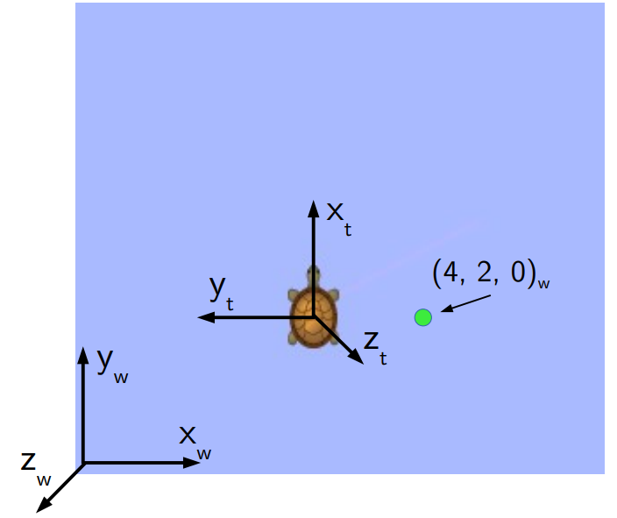


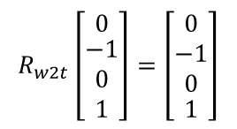
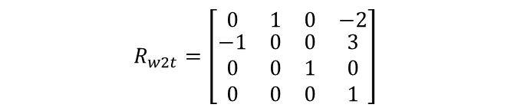
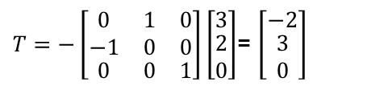
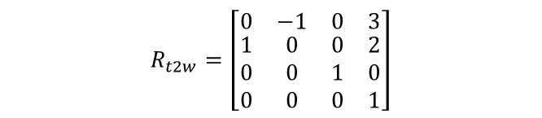
What is (4,2,0)w in turtle coordinates?
$$R_{t2w}=\left[\begin{matrix}0 & −1 & 0 & 3 \\ \begin{aligned}1 \\ 0 \\ 0\end{aligned} & \begin{aligned}0 \\ 0 \\ 0\end{aligned} & \begin{aligned}0 \\ 1 \\ 0\end{aligned} & \begin{aligned}2 \\ 0 \\ 1\end{aligned}\end{matrix}\right]$$
$T=−\left[\begin{matrix}\begin{aligned}0 \\ −1\end{aligned} & \begin{aligned}1 \\ 0\end{aligned} & \begin{aligned}0 \\ 0\end{aligned} \\ 0 & 0 & 1\end{matrix}\right]\left[\begin{matrix}3 \\ \begin{aligned}2 \\ 0\end{aligned}\end{matrix}\right]$= $\left[\begin{matrix}−2 \\ \begin{aligned}3 \\ 0\end{aligned}\end{matrix}\right]$
$$R_{w2t}=\left[\begin{matrix}0 & 1 & 0 & −2 \\ \begin{aligned}−1 \\ 0 \\ 0\end{aligned} & \begin{aligned}0 \\ 0 \\ 0\end{aligned} & \begin{aligned}0 \\ 1 \\ 0\end{aligned} & \begin{aligned}3 \\ 0 \\ 1\end{aligned}\end{matrix}\right]$$
$$R_{w2t}\left[\begin{matrix}0 \\ \begin{aligned}−1 \\ 0 \\ 1\end{aligned}\end{matrix}\right]=\left[\begin{matrix}\begin{aligned}0 \\ −1 \\ 0\end{aligned} \\ 1\end{matrix}\right]$$
Low level / classical vision
Notes:
https://w3.cs.jmu.edu/spragunr/CS354_F22/lectures/kinematics/kinematics.pdf
https://w3.cs.jmu.edu/spragunr/CS354_F22/readings/frames.pdf

Slide 5
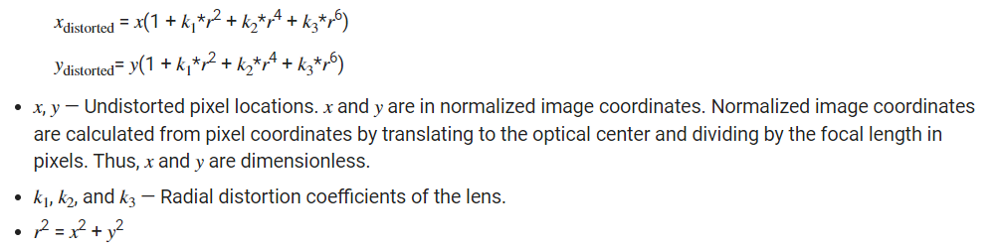
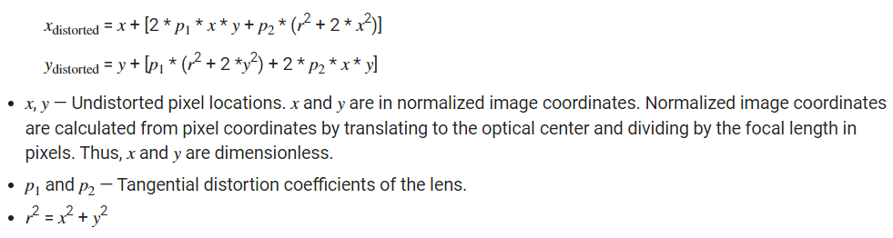
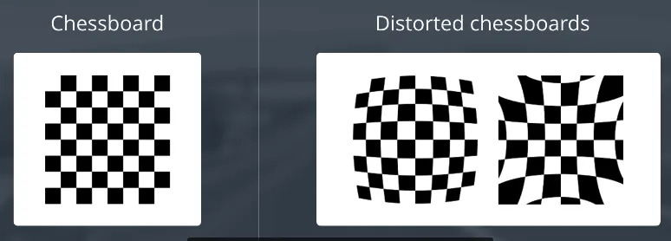
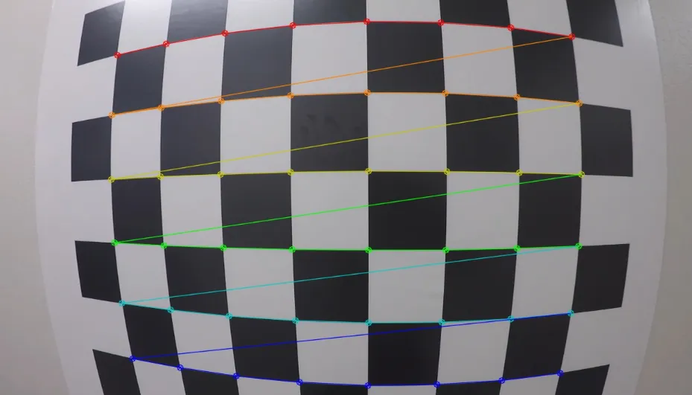
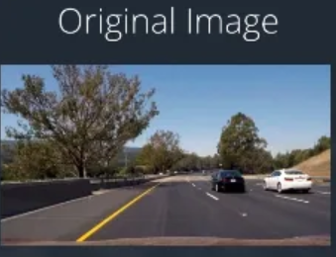
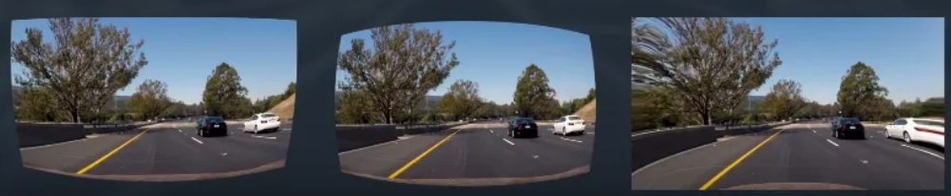
What are 2 types of camera distortion and how can it be corrected?
Can use a library like opencv to find distortion coefficients given multiple checkerboard imgs
chessboard is great for calibration because its regular, high contrast pattern makes it easy to detect automatically. And we know how an undistorted flat chessboard looks like
Radial
Tangential
Left/middle are radial distortion, right is tangential distortion.
Low level / classical vision
Notes:
https://docs.opencv.org/4.x/dc/dbb/tutorial_py_calibration.html
https://de.mathworks.com/help/vision/ug/camera-calibration.html
https://medium.com/analytics-vidhya/camera-calibration-with-opencv-f324679c6eb7

Slide 6
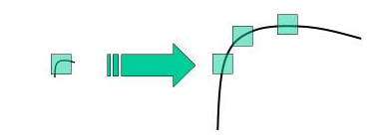
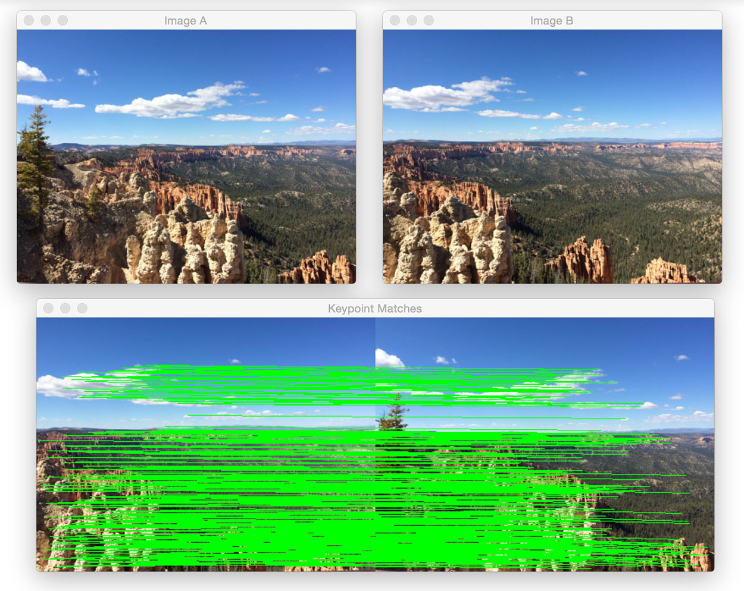
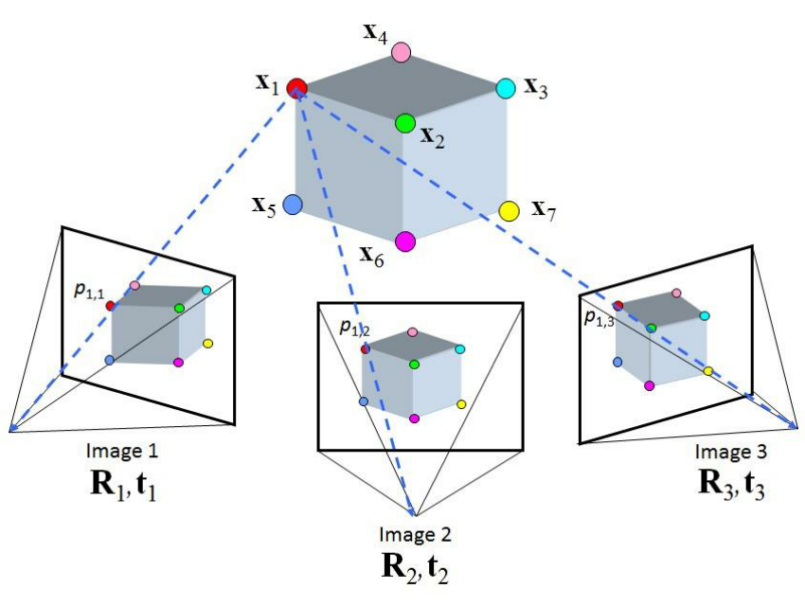
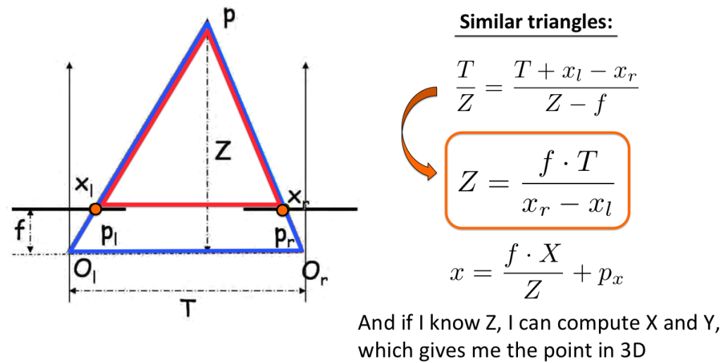
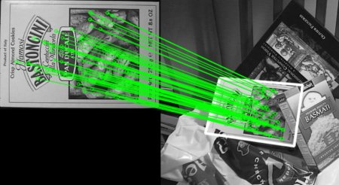
What is SIFT and what problems does it tackle?
The Scale-Invariant Feature Transform (1999) is a feature detection algorithm which is scale and rotation invariant.
It is an improvement of things like the Harris corner detector (1988), which is only rotation invariant (since, corners look like lines when zoomed in)
Once you obtain SIFT keypoints for one image, you can recognize objects in other images by getting its SIFT keypoints and comparing them to the original keypoints with euclidean distance of the feature vectors, thus establishing correspondences. In general, the process of matching features is called image registration.
Downstream uses include:
Object recognition (if number of high confidence correspondences exceed a threshold)
Robot localization (by feature mapping to a known 3D map)
Depth estimation (By using SIFT to generate correspondences between stereo images)
Structure from motion (By using SIFT to generate correspondences between many images; if camera parameters are known, we get the depth of an object and can generate a pointcloud or mesh)
Panorama stitching/image alignment
Motion tracking of an object
Feature-based optical flow
Depth Estimation
Image Stitching
SfM
Correspondences
Low level / classical vision
Notes:
https://www.analyticsvidhya.com/blog/2019/10/detailed-guide-powerful-sift-technique-image-matching-python/
http://www.cs.toronto.edu/~fidler/slides/2015/CSC420/lecture12_hres.pdf
https://math.stackexchange.com/questions/2388259/differences-between-homography-and-transformation-matrix

Slide 7
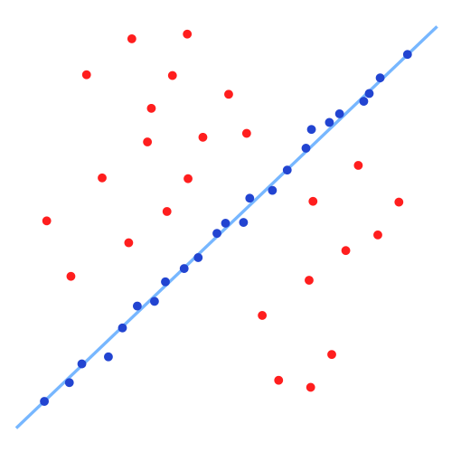
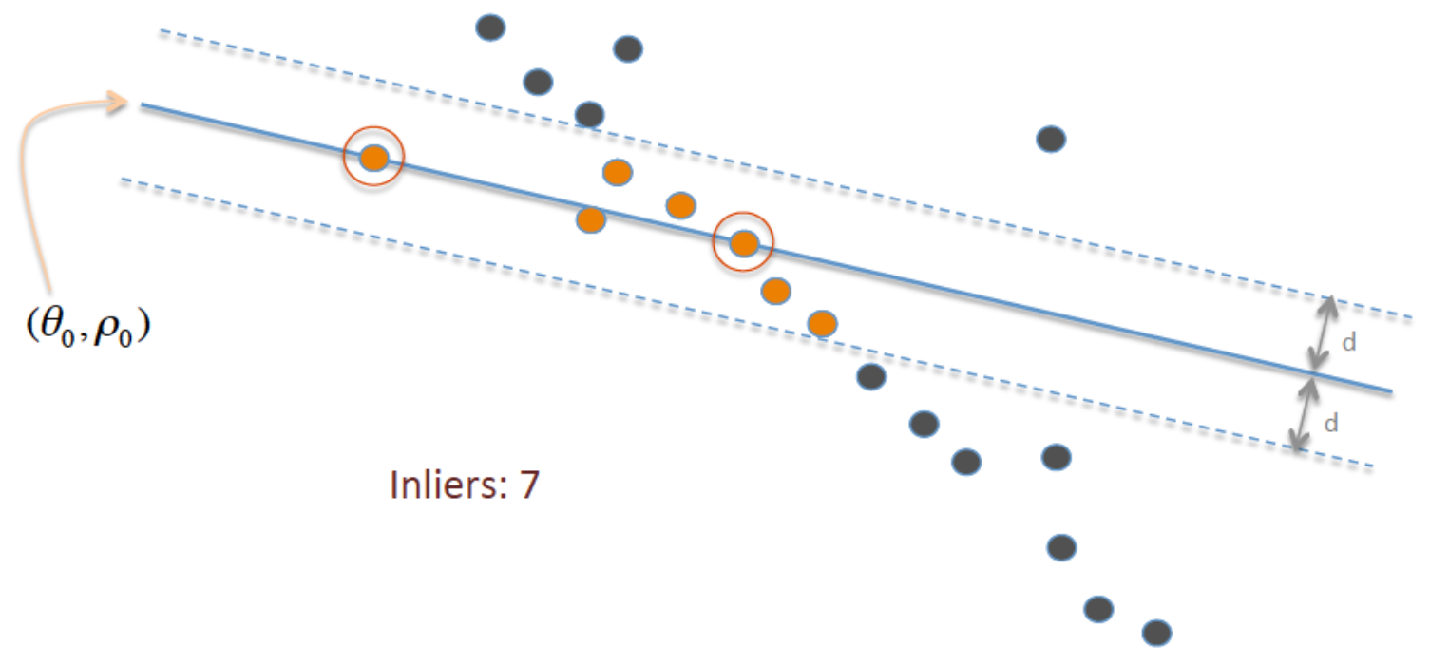
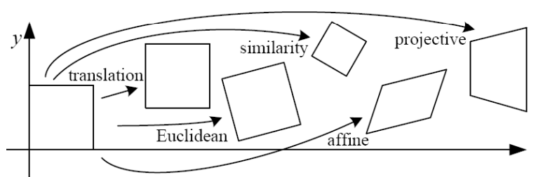
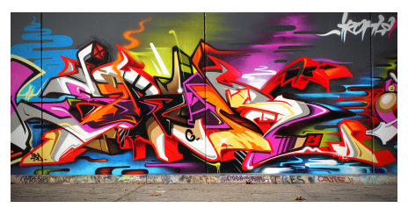
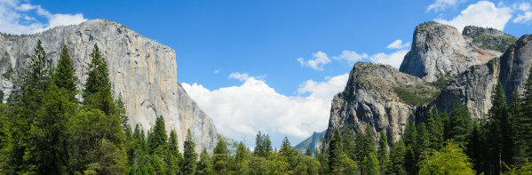
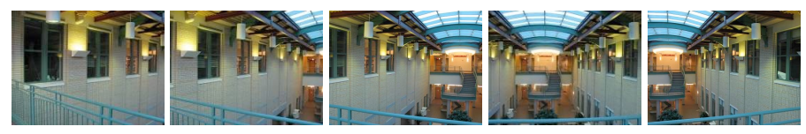
What is RANSAC and how can it be used to find correspondences?
Random sample consensus (RANSAC) is an iterative probabilistic method to estimate parameters of a mathematical model from a set of observed data that contains outliers. Here, outliers are not given any influence on the values of the estimates; only inliers.
RANSAC psuedocode:
Input to RANSAC: set of observed data values, way of fitting some kind of parameterized model to the observations, and some hyperparameters
Until convergence:
Select a very small random subset of the original data. Call this subset the hypothetical inliers.
A model is fitted to the set of hypothetical inliers.
All other data are then tested against the fitted model. Those points that fit the estimated model well, according to some model-specific loss function, are considered as part of the consensus set.
The estimated model is reasonably good if sufficiently many points have been classified as part of the consensus set.
Afterwards, the model may be improved by reestimating it using all members of the consensus set.
For example, RANSAC can be applied to linear regression to exclude outliers.
It fits linear models to several very small random samplings of the data and returns the model that has the best fit to a subset of the data.
Since the inliers tend to be more linearly related than a random mixture of inliers and outliers, a random subset that consists entirely of inliers will have the best model fit.
In practice, there is no guarantee that a subset of inliers will be randomly sampled, and the probability of the algorithm succeeding depends on the proportion of inliers in the data as well as the choice of several algorithm parameters.
RANSAC can be applied to find correspondences between SIFT features in two images. In this case, the model is a homography (aka projective transformation) that attempts to align two images taken from different perspectives together.
A homography is a isomorphism between two vector spaces; ie, representable by a nonsingular matrix.
Homographies are viable either of the following are true:
The scene is planar or approximately planar (ie, the scene is very far or has small relative depth variation)
The scene is captured under camera rotation only (no translation or pose change)
At a high level to use RANSAC for SIFT correspondences, you repeatedly:
Randomly pick 4 good matches (based on l2 distance); compute homography
Check how many good matches are consistent with homography, to find hypothetical inliers/outliers
In the end, you keep the homography with the smallest number of outliers.
Left is Planar; Right is Approx Planar due to distance; Bottom is captured under cam. Rotation only
Low level / classical vision
Notes:
https://en.wikipedia.org/wiki/Random_sample_consensus
https://cs.stackexchange.com/questions/70434/how-is-ransac-used-to-estimate-a-homography-given-the-descriptors-of-both-images
https://math.stackexchange.com/questions/1745762/a-deeper-understanding-interpretation-of-homographies
https://math.stackexchange.com/questions/2388259/differences-between-homography-and-transformation-matrix
https://www.cs.ubc.ca/~lsigal/425_2018W2/Lecture16a.pdf

Slide 8
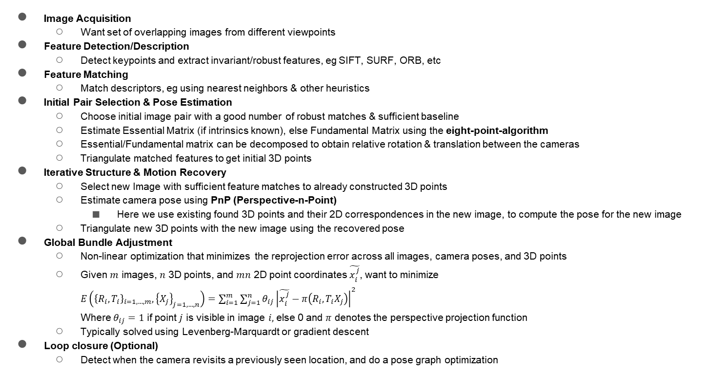
Describe the steps that go into a classical structure from motion pipeline, eg COLMAP for Offline, ORB-SLAM or Online.
Image Acquisition
Want set of overlapping images from different viewpoints
Feature Detection/Description
Detect keypoints and extract invariant/robust features, eg SIFT, SURF, ORB, etc
Feature Matching
Match descriptors, eg using nearest neighbors & other heuristics
Initial Pair Selection & Pose Estimation
Choose initial image pair with a good number of robust matches & sufficient baseline
Estimate Essential Matrix (if intrinsics known), else Fundamental Matrix using the eight-point-algorithm
Essential/Fundamental matrix can be decomposed to obtain relative rotation & translation between the cameras
Triangulate matched features to get initial 3D points
Iterative Structure & Motion Recovery
Select new Image with sufficient feature matches to already constructed 3D points
Estimate camera pose using PnP (Perspective-n-Point)
Here we use existing found 3D points and their 2D correspondences in the new image, to compute the pose for the new image
Triangulate new 3D points with the new image using the recovered pose
Global Bundle Adjustment
Non-linear optimization that minimizes the reprojection error across all images, camera poses, and 3D points
Given $m$ images, $n$ 3D points, and $mn$ 2D point coordinates $\tilde{x_{i}^{j}}$, want to minimize
$E\left({\left\{R_{i},T_{i}\right\}}_{i=1,…,m}, {\left\{X_{j}\right\}}_{j=1,…,n}\right)=\sum_{i=1}^{m}{\sum_{j=1}^{n}{θ_{ij}{\left|\tilde{x_{i}^{j}}−π\left(R_{i},T_{i}X_{j}\right)\right|}^{2}}}$
Where $θ_{ij}=1$ if point $j$ is visible in image $i,$ else 0 and $π$ denotes the perspective projection function
Typically solved using Levenberg-Marquardt or gradient descent
Loop closure (Optional)
Detect when the camera revisits a previously seen location, and do a pose graph optimization

Slide 9
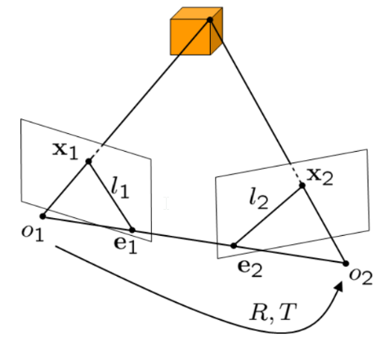
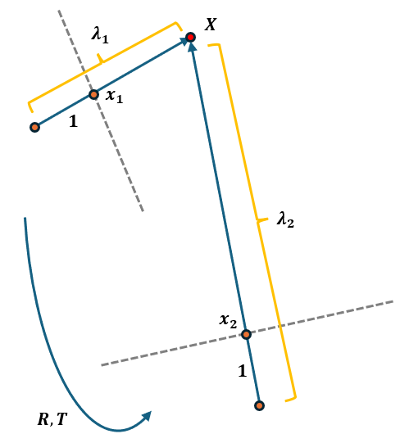
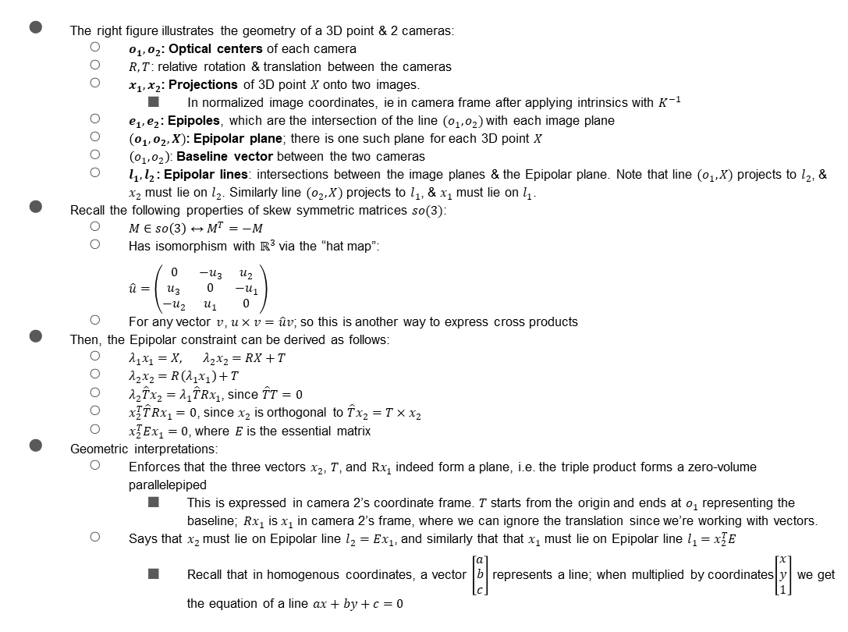

Derive the epipolar constraint & describe its geometric interpretations.
$$X$$
The right figure illustrates the geometry of a 3D point & 2 cameras:
$o_{1},o_{2}$: Optical centers of each camera
$R,T$: relative rotation & translation between the cameras
$x_{1},x_{2}$: Projections of 3D point $X$ onto two images.
In normalized image coordinates, ie in camera frame after applying intrinsics with $K^{−1}$
$e_{1},e_{2}$: Epipoles, which are the intersection of the line $(o_{1},o_{2})$ with each image plane
$(o_{1},o_{2},X)$: Epipolar plane; there is one such plane for each 3D point $X$
$\left(o_{1},o_{2}\right)$: Baseline vector between the two cameras
$l_{1},l_{2}$: Epipolar lines: intersections between the image planes & the Epipolar plane. Note that line $(o_{1},X)$ projects to $l_{2}$, & $x_{2}$ must lie on $l_{2}$. Similarly line $(o_{2},X)$ projects to $l_{1}$, & $x_{1}$ must lie on $l_{1}$.
Recall the following properties of skew symmetric matrices $so(3)$:
$M∈so\left(3\right)↔M^{T}=−M$
Has isomorphism with $ℝ^{3}$ via the “hat map”:
$\hat{u}=\left(\begin{matrix}0 & −u_{3} & u_{2} \\ u_{3} & 0 & −u_{1} \\ −u_{2} & u_{1} & 0\end{matrix}\right)$
For any vector $v$, $u×v=\hat{u}v$; so this is another way to express cross products
Then, the Epipolar constraint can be derived as follows:
$λ_{1}x_{1}=X, λ_{2}x_{2}=RX+T$
$λ_{2}x_{2}=R\left(λ_{1}x_{1}\right)+T$
$λ_{2}\hat{T}x_{2}=λ_{1}\hat{T}Rx_{1}$, since $\hat{T}T=0$
$x_{2}^{T}\hat{T}Rx_{1}=0$, since $x_{2}$ is orthogonal to $\hat{T}x_{2}=T×x_{2}$
$x_{2}^{T}Ex_{1}=0$, where $E$ is the essential matrix
Geometric interpretations:
Enforces that the three vectors $x_{2}$, $T$, and $Rx_{1}$ indeed form a plane, i.e. the triple product forms a zero-volume parallelepiped
This is expressed in camera 2’s coordinate frame. $T$ starts from the origin and ends at $o_{1}$ representing the baseline; $Rx_{1}$ is $x_{1}$ in camera 2’s frame, where we can ignore the translation since we’re working with vectors.
Says that $x_{2}$ must lie on Epipolar line $l_{2}=Ex_{1}$, and similarly that that $x_{1}$ must lie on Epipolar line $l_{1}=x_{2}^{T}E$
Recall that in homogenous coordinates, a vector $\left[\begin{matrix}a \\ b \\ c\end{matrix}\right]$ represents a line; when multiplied by coordinates$\left[\begin{matrix}x \\ y \\ 1\end{matrix}\right]$ we get the equation of a line $ax+by+c=0$

Slide 10
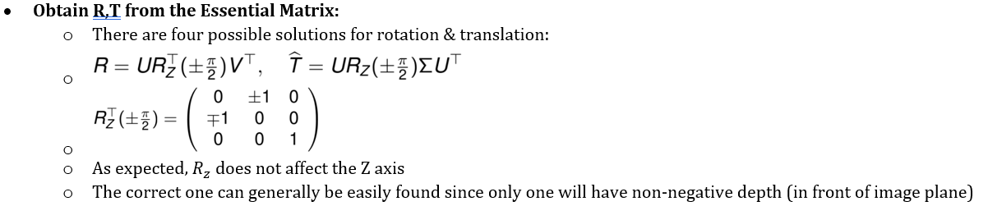
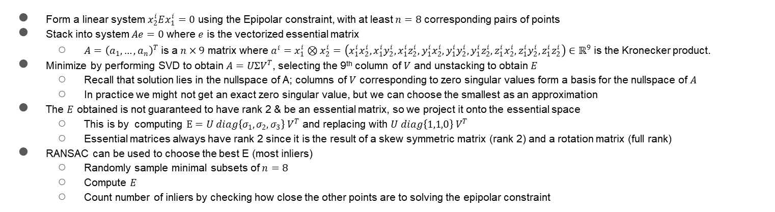
How is R, T estimated using the eight-point algorithm?
Form a linear system $x_{2}^{i}Ex_{1}^{i}=0$ using the Epipolar constraint, with at least $n=8$ corresponding pairs of points
Stack into system $Ae=0$ where $e$ is the vectorized essential matrix
$A={\left(a_{1},…,a_{n}\right)}^{T}$ is a $n×9$ matrix where $a^{i}=x_{1}^{i}⊗x_{2}^{i}=\left(x_{1}^{i}x_{2}^{i},x_{1}^{i}y_{2}^{i},x_{1}^{i}z_{2}^{i},y_{1}^{i}x_{2}^{i},y_{1}^{i}y_{2}^{i},y_{1}^{i}z_{2}^{i},z_{1}^{i}x_{2}^{i},z_{1}^{i}y_{2}^{i},z_{1}^{i}z_{2}^{i}\right)∈ℝ^{9}$ is the Kronecker product.
Minimize by performing SVD to obtain $A=UΣV^{T}$, selecting the 9th column of $V$ and unstacking to obtain $E$
Recall that solution lies in the nullspace of A; columns of $V$ corresponding to zero singular values form a basis for the nullspace of $A$
In practice we might not get an exact zero singular value, but we can choose the smallest as an approximation
The $E$ obtained is not guaranteed to have rank 2 & be an essential matrix, so we project it onto the essential space
This is by computing $E=U diag\left\{σ_{1},σ_{2},σ_{3}\right\} V^{T}$ and replacing with $U diag\left\{1,1,0\right\} V^{T}$
Essential matrices always have rank 2 since it is the result of a skew symmetric matrix (rank 2) and a rotation matrix (full rank)
RANSAC can be used to choose the best E (most inliers)
Randomly sample minimal subsets of $n=8$
Compute $E$
Count number of inliers by checking how close the other points are to solving the epipolar constraint

Slide 11
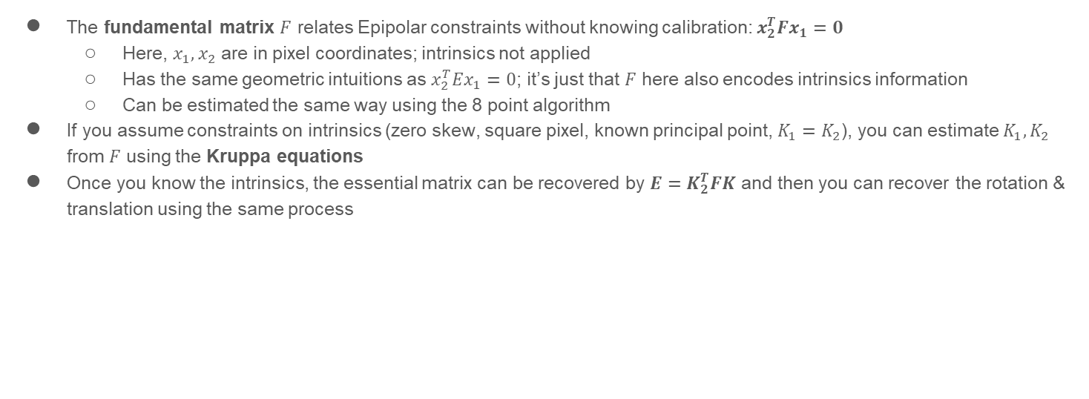
How does the fundamental differ from the essential matrix? How can you recover the rotation & translation from the fundamental matrix?
The fundamental matrix $F$ relates Epipolar constraints without knowing calibration: $x_{2}^{T}Fx_{1}=0$
Here, $x_{1},x_{2}$ are in pixel coordinates; intrinsics not applied
Has the same geometric intuitions as $x_{2}^{T}Ex_{1}=0$; it’s just that $F$ here also encodes intrinsics information
Can be estimated the same way using the 8 point algorithm
If you assume constraints on intrinsics (zero skew, square pixel, known principal point, $K_{1}=K_{2}$), you can estimate $K_{1},K_{2}$ from $F$ using the Kruppa equations
Once you know the intrinsics, the essential matrix can be recovered by $E=K_{2}^{T}FK$ and then you can recover the rotation & translation using the same process

Slide 12
Deep Learning Fundamentals

Slide 13
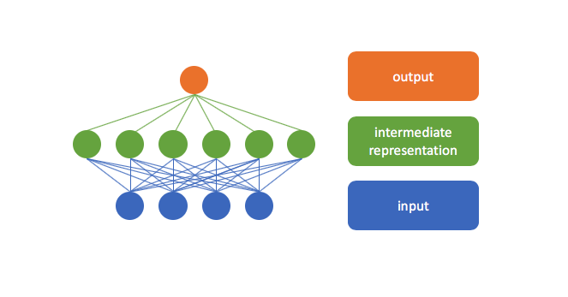
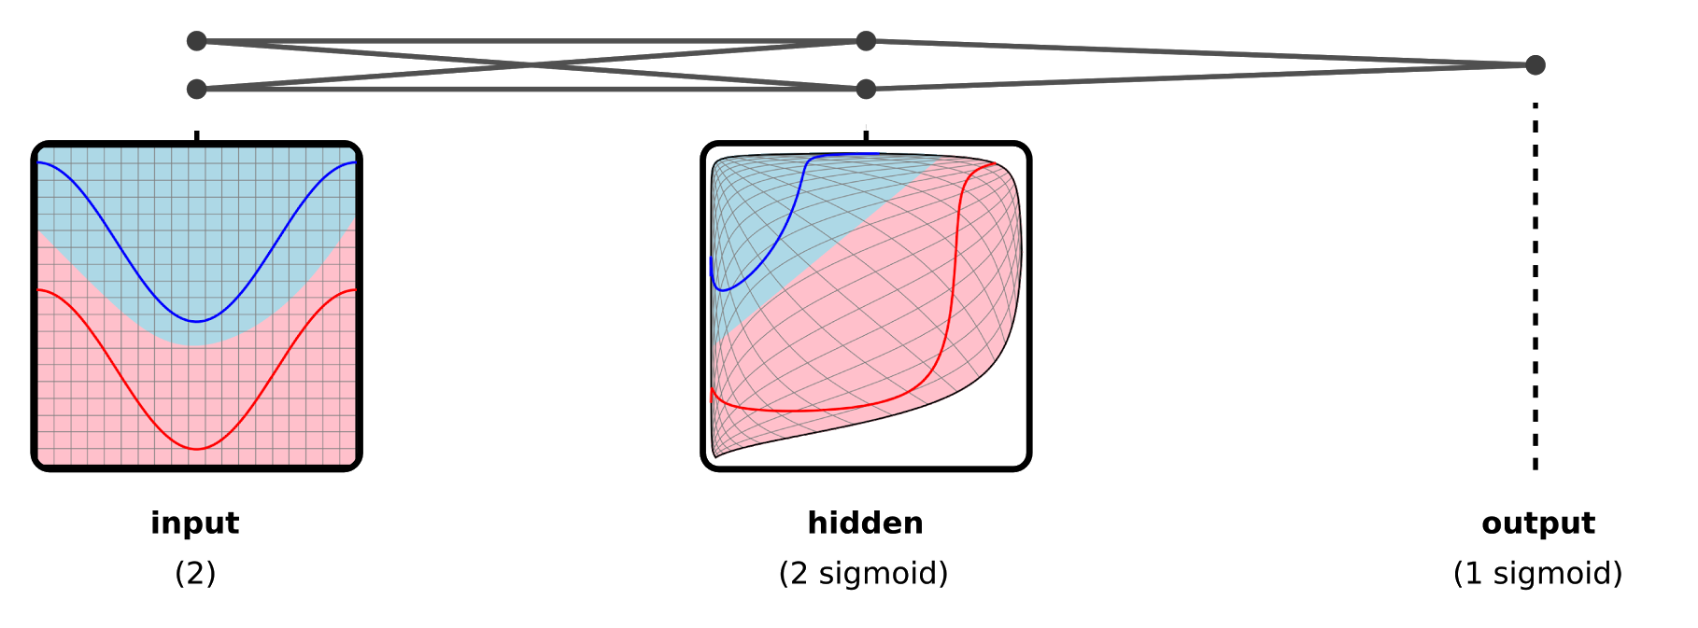

In general, how do neural networks operate?
Parametrized models which we optimize using a task-specific objective function, over a training dataset
One perspective: takes inputs, transforms them into a useful internal feature representation which is linearly separable(i.e. feature extractor), and applies a linear (e.g. softmax) classifier at the end.
Deep Learning Fundamentals

Slide 14
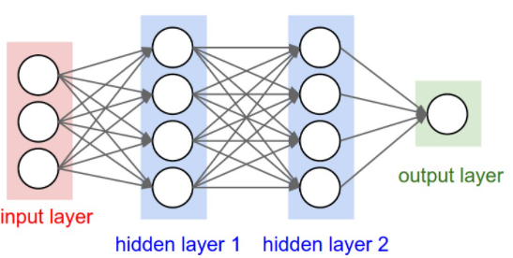
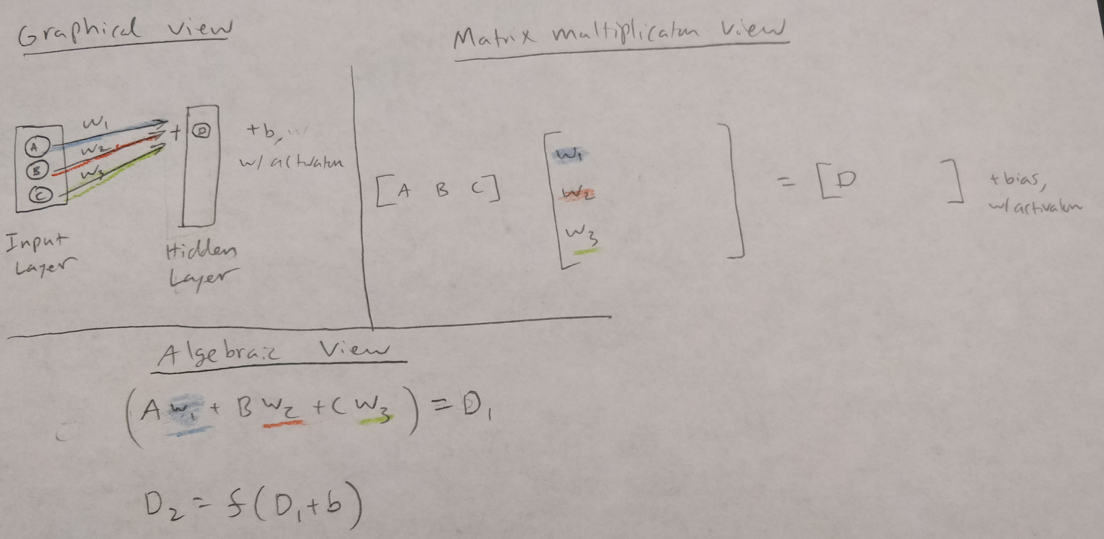
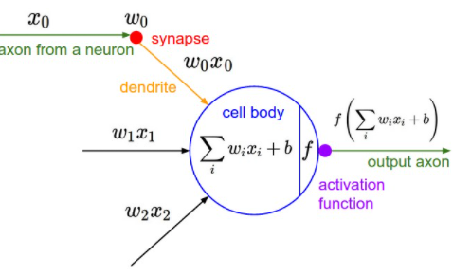
How many neurons & parameters does the below neural network have? Explain the Matrix multiplication view, graphical view, algebraic view, and biological view.
Neurons: 9, not including inputs
[3 x 4] + [4 x 4] + [4 x 1] = 12 + 16 + 4 = 32 weights and 4 + 4 + 1 = 9 biases, for a total of 41 learnable parameters.
The 3 sets of arrows all represent an n*k matrix, where n is the number of neurons in the left layer and k is the number of neurons in the right layer.
Deep Learning Fundamentals

Slide 15
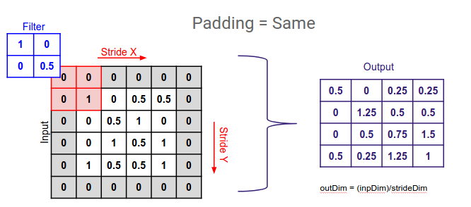
What is the output depth, padding, stride, and filter size of a conv layer?
Output depth (O): equal to the number of filters used in the convolutional layer.
Padding (P): The amount of zero padding before convolutions, which can help maintain the spatial size of the input/output volumes.
Stride (S): The number of positions we move as we slide the filter around. For example, if this is 2, then the output volume is halved spatially (given sufficient padding)
Filter Size (F): Determines how large the receptive field is
Also called the kernel size
Deep Learning Fundamentals
Notes:
https://stanford.edu/~shervine/teaching/cs-230/cheatsheet-convolutional-neural-networks
https://www.quora.com/What-is-a-neuron-in-the-context-of-Convolutional-Neural-Network

Slide 16
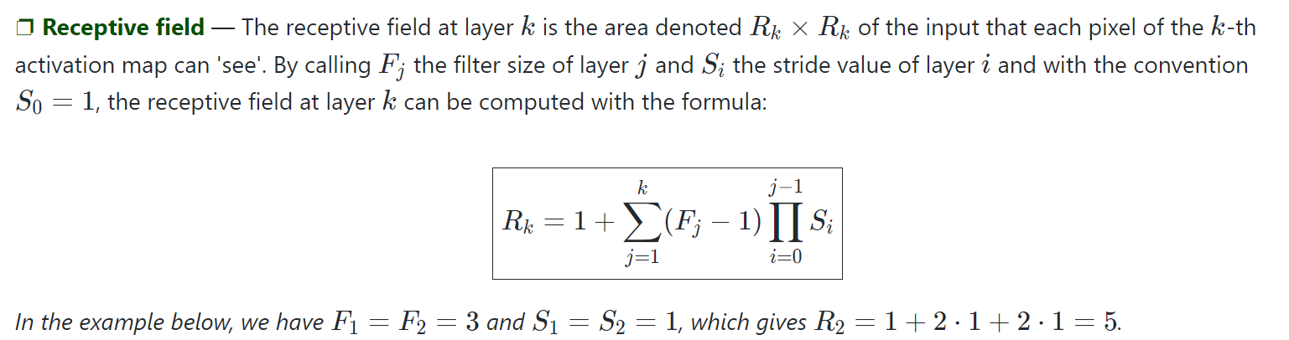
What makes convnets translationally invariant? What is the “receptive field”?
Translational invariance occurs because each filter learns parameters which are the same spatially, and slid across the image.
Deep Learning Fundamentals
Notes:
https://stanford.edu/~shervine/teaching/cs-230/cheatsheet-convolutional-neural-networks
https://www.quora.com/What-is-a-neuron-in-the-context-of-Convolutional-Neural-Network

Slide 17
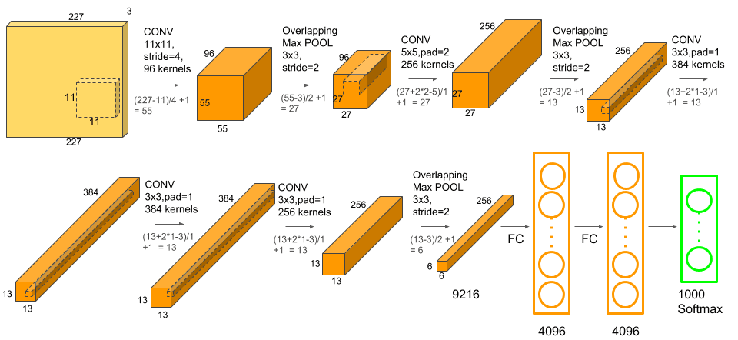
How do you calculate output volume size of a conv layer given input size W, padding P, stride S, filter (kernel) size F, and O filters? How do you maintain the spatial size for filter sizes 3 and 5?
What about a pooling layer of input size W, filter size F and stride S?
Conv layer: Output spatial size will be D = ((W+2P-F)/S) + 1; output feature map size will be O x D x D
Pooling layer: ((W-F)/S)+1; output depth stays the same
To maintain spatial sizes:
For F=3, use P=1
For F=5, use P=2
Deep Learning Fundamentals

Slide 18
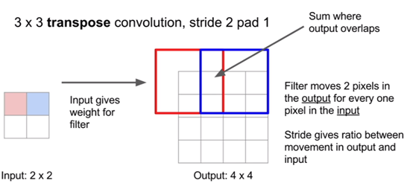
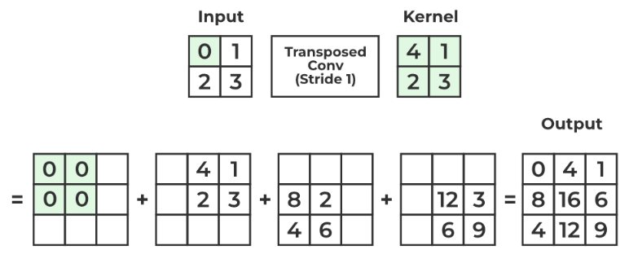
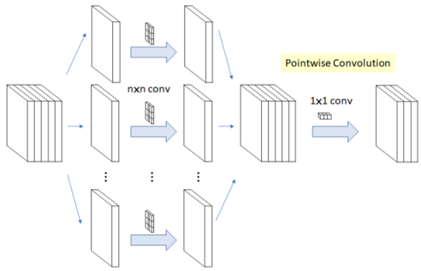



Explain regular, pointwise/1x1, transpose/up/de/fractionally strided, atrous/dilated, and depthwise separable convolutions.
Regular Convolutions Example of a kernel/filter: n x n x c, where c is input feature map’s channel size Dot products are computed, sliding across input feature map Each filter outputs 1 channel. For example, if we want our output to have 256 channels, we need 256 filters | 1x1 Convolutions Same as regular conv, but 1 x 1 x c filters. This keeps the spatial dimensions, but changes the channels Useful for dim. reduction, and introducing nonlinearities Output array from each filter after convolving with input can be thought of as a weighted sum of the input feature map’s channels | De/Up/Transpose/fractionally strided Conv. Instead of sliding kernel over input & dot prod, input gives weight for filter and we sum where we overlap. | Atrous/Dilated Conv. Adds gaps in the filter when convolving, increasing the field of view even with the same number of parameters. However, this does not spatially upsample | Depthwise Separable Conv. (From MobileNet) For efficiency, this operation decomposes the regular convolution into two stages: A depthwise convolution operation, preserving the depth C of the input. C many “groups” (pytorch terminology) of n x n x 1 channel-specific kernels are used, each separately applied to each channel of the input to get C channels. 1 x 1 pointwise convolutions are used, to get desired depth.
Normal (top) vs depthwise (bottom) conv
Deep Learning Fundamentals
Notes:
https://towardsdatascience.com/a-basic-introduction-to-separable-convolutions-b99ec3102728
https://towardsdatascience.com/types-of-convolutions-in-deep-learning-717013397f4d
python - Implement SeparableConv2D in Pytorch - Stack Overflow

Slide 19

Derive the number of multiplications needed for depthwise separable vs regular convolutions, given an H x W input volume, a K x K filter, M channels in, and N channels out.
$$\frac{depthwise}{regular }=\frac{KKHWM+HWMN}{KKHWMN}=\frac{HWM\left(KK+N\right)}{KKHWMN}=\frac{KK+N}{KKN}=\frac{1}{N}+\frac{1}{K^{2}}$$

Slide 20


What are grouped convolutions?
Standard conv
Grouped conv
Deep Learning Fundamentals

Slide 21

What are coord convolutions?
While CNNs are powerful at learning hierarchical features, they don't inherently have built-in mechanisms for understanding the absolute or relative positions of objects within an image
Adding coordinate channels provide the network with explicit spatial information, which can help it understand the location and orientation of objects in the input image
Coordinate channels are typically computed as normalized values, meaning that the coordinates are scaled to a specific range (e.g., [-1, 1] or [0, 1]) to ensure that they don't dominate the other feature channels
Deep Learning Fundamentals

Slide 22

How does max and average differ? Which is more popular? Why do some dislike pooling altogether?
Max/average pooling just downsizes the spatial size, while keeping the feature dimension the same.
Both are applied separately for each of the input channels
Some think that averaging all features in a very large region might just kill a lot of the information there
Some people dislike the pooling operation and there has been work suggesting that we should avoid it in favor of convolutions that downsample by using larger stride once in a while. One example is the All-Convolutional Network paper (ICLR 15, 1500 cit.). This is also adopted in ResNet. This has been seen to be especially important in VAEs and GANs.
Deep Learning Fundamentals

Slide 23



What is the softmax function, and what loss function is it usually associated with?
The softmax is often paired with the cross-entropy loss (aka negative log likelihood), which operates on vectors of class probabilities.
Deep Learning Fundamentals

Slide 24





Draw and describe the following activation functions: sigmoid, ReLU, leaky ReLU, ReLU6, tanh,
Leaky ReLU (usually a is around 0.01)
Some notes:
Sigmoid and tanh can lead to vanishing gradients, so ReLU is most often used in the hidden layers
In the binary case, sigmoid is equivalent to the softmax function where we just set one of the output nodes to be constant 0.
Although ReLU is non-differentiable at 0, it’s rare to have x = 0 exactly, and even it it is, we usually just hard-code it as 0, 1, or 0.5.
Leaky ReLU avoids the issue of neurons being deactivated if negative.
ReLU6 helps limit range for QAT precision
Deep Learning Fundamentals
Notes:
https://stats.stackexchange.com/questions/207049/neural-network-for-binary-classification-use-1-or-2-output-neurons

Slide 25


What is gradient descent?
Given a function and an initial starting point on the domain of the function, gradient descent tries to find a local minima by repeatedly:
Computing the gradient at the current position (ie, calculate the derivative/direction of steepest ascent for each variable, which combines to form a vector)
Updating the current position: subtracting the current position by the gradient times a small step size
In the context of neural networks:
The variables to optimize are the parameters of your neural network.
The function is called a loss function, and involves your training data. Usually, you sample a minibatch of the data.
Thus in minibatch gradient descent, the loss function actually changes with each iteration. Usually it changes in a linear way; terms in the summation of the loss function are left out depending on what examples are in the minibatch. This results in the loss function landscape (and consequently, gradient computed for the training step), being an approximation towards the overall loss function we actually wish to minimize, which incorporates all training examples. In practice, this approximation is worth it because it allows for more frequent updates.
Loss function landscapes are highly non-convex, but regularizers can help improve the smoothness and prevent being stuck at saddle points too often
This is called “conditioning”, and includes initialization, (batch/layer/etc) normalization, and residual connections
Deep Learning Fundamentals

Slide 26










At a high level describe SGD + momentum, adagrad, RMSprop, and Adam. Also explain (Multi)StepLR and reduceLROnPlateau.
SGD + Momentum (Same learning rate applied to all parameters)
Adds the gradient at the last time step (times a momentum factor) with the current gradient.
The momentum term increases for dimensions whose gradients point in the same directions and reduces updates for dimensions whose gradients change directions. This helps with faster convergence and less oscillation.
AdaGrad (Learning rate per parameter)
Divides the learning rate by the sum of squared gradients of each parameter up to the current timestep.
Parameters with past large gradients gets its learning rate progressively reduced more than those with smaller gradients.
Since we are squaring the gradients, the learning rate is monotonically decreasing in a quite aggressive way.
AdaDelta/RMSprop (Learning rate per parameter)
Learning rate is divided by the square root of a running weighted average of all past squared gradients for that parameter.
Similar to AdaGrad, params with previous large gradients get diminished more than those with smaller past gradients but less aggressive
Adam (Learning rate per parameter)
Keeps an (weighted) exponential moving average of the gradient and the squared gradient (ie, the first two moments)
The weighted gradient is used, and the learning rate is divided by the square root of the squared gradient.
Lower variance is more stable so will have higher learning rate; higher variance is unstable so will have lower learning rate
An additional benefit to note for the last three is that their adaptive nature makes the optimization more robust to learning rate.
Besides these, pytorch also has other schedulers, for example:
torch.optim.lr_scheduler.StepLR
Decays learning rate by multiplication with gamma every step_size epochs.
torch.optim.lr_scheduler.MultiStepLR
Decays learning rate by multiplication with gamma every time a specified milestone epoch is reached.
torch.optim.lr_scheduler.ReduceLROnPlateau
Reads a metric quantity and if no improvement (up to a threshold) is seen for a patience number of epochs, the learning rate is reduced by multiplication with gamma.
In some cases, two optimization schemes can complement each other, even if both adjust learning rates (eg, adam + StepLR scheduler; latter affects the base learning rate $η$)
G_ii is the sum of squared gradients of theta_i up to time t.
Deep Learning Fundamentals
Notes:
https://discuss.pytorch.org/t/with-adam-optimizer-is-it-necessary-to-use-a-learning-scheduler/66477/2
https://ruder.io/optimizing-gradient-descent/index.html#momentum
https://spell.ml/blog/lr-schedulers-and-adaptive-optimizers-YHmwMhAAACYADm6F

Slide 27

How does the Muon optimizer work?
Muon (“MomentUm Orthogonalized by Newton–Schulz”) is a geometry driven NN optimizer, specialized for 2D matrix parameters (eg in hidden/linear layers)
Takes SGD-momentum updates and semi-orthogonalizes them using an algorithm using Netwon-Schultz
An orthogonal matrix’s columns & rows form an orthogonal set; they’re pairwise perpendicular & have unit length
Thus, intuitively this helps train more efficiently by giving importance to “rare directions” that are often overlooked by Adam or SGD outputs
Has set training speed records, and scales to larger LLMs
Notes:
https://kellerjordan.github.io/posts/muon/

Slide 28



What is the intuition behind cosine annealing with warm restarts / warmups?
By periodically increasing the learning rate and providing a "kickstart" to the optimization process, warm restarts can help the neural network escape local minima and explore different parts of the loss landscape
Warm restarts reduce the sensitivity to the initial learning rate and learning rate schedule hyperparameters, making it easier to find effective hyperparameters for training.
it's generally a good idea to include a warmup in the lr schedule (e.g. linearly from 0 to target staring LR), as the gradient distribution without the warmup can be distorted, leading to the optimizer being trapped in a bad local min
Deep Learning Fundamentals
Notes:
https://towardsdatascience.com/a-visual-guide-to-learning-rate-schedulers-in-pytorch-24bbb262c863

Slide 29
Describe how weights are usually initialized for neural networks. Can you just set them to 0?
You can’t set them to 0 because the model can get “stuck”. For example, for ReLU activations, the output will all be 0, and the gradients will be 0. This is a saddle point in parameter space.
The simplest way to initialize weights is to sample uniformly in a range, such as [-0.2, 0.2], or from a normal distribution such as N(0, 0.1).
A popular alternative is Kaiming He normal initialization, which samples from N(0, sqrt(2/n)) where n is the number of inputs to the node. Intuitively, the 1/n is there to ensure that the input variance is similar to the output variance (recall that if Xs are independent, Var(X+X+...+X) = N*Var(X)).
Pytorch actually uses kaiming_uniform initialization by default, which samples uniformly from [-sqrt(6/n), sqrt(6/n)].\
Intuitively, when there is more variability in the inputs (ie, as n gets larger), the range of the distribution shrinks to reduce variability.
Deep Learning Fundamentals
Notes:
https://www.quora.com/What-an-intuitive-explanation-of-He-initialization-for-artificial-Neural-Networks
https://machinelearningmastery.com/weight-initialization-for-deep-learning-neural-networks/

Slide 30



Describe some basic regularization techniques (5).
Adding more data
The best (but also, expensive) to avoid overfitting is to add more training data.
With enough training data, it can make it so that the models fundamentally has a hard time overfitting on the data, even if it wanted to.
L2 Weight Decay
We effectively add a squared term to the cost function (top equation), and when the gradient is taken we are essentially decaying the weight proportional to its size. This limits the expressive power of the neural network.
L2 exacerbates the decay on the larger weights; however, L1 is also possible which encourages some features to be 0 completely (discarded).
In a way, reduces the parameters of the model without explicitly doing so (ie instead of forcing a lower capacity, the network can learn which nodes to shut off)
Dropout
When training, only keep a neuron active with some probability p. At test time, all neurons are active.
It is necessary to scale outputs at test time appropriately, by multiplying by dropout rate p.
Intuitively, this affects the model in a semantic, feature level way and could force it to detect new features for classification, leading to generalization and robustness.
Mostly used for the final fully connected layers. It generally is not helpful for convolutional layers.
Seems to be falling out of favor, and now mostly batchnorm is used.
Data augmentation
Includes horizontal/vertical flipping, random cropping, gaussian noise, rotation, scaling, translation, brightness, contrast, color augmentation.
Early Stopping
Tries to stop just before the point where improving the model’s fit to the training data comes at the expense of increased generalization error.
Can be early stopped when validation performance starts to decrease for a given number of epochs
Deep Learning Fundamentals
Notes:
https://stats.stackexchange.com/questions/29130/difference-between-neural-net-weight-decay-and-learning-rate
https://towardsdatascience.com/dropout-on-convolutional-layers-is-weird-5c6ab14f19b2

Slide 31

What is batchnorm and why does it work? Does it go before/after ReLU? What happens at test time? What are some other considerations?
Implementation Notes:
Makes training faster and more stable
For convolutional layers: we want different elements of the same conv filter to be normalized in the same way. Thus, the normalization is performed at the per-channel level, over the batch.
Batch normalization adds two trainable parameters γ and β to each layer. These ensure that the expressiveness of the neural network is still constant.
Batchnorm goes before the activations, generally
Rationale is that you will have your data happily centered around the non-linearity, so you get the most benefit out of it. Imagine your data being all <0, then ReLu will have no effect at all; you normalize it: problem solved.
Usually, when you use batchnorm dropout becomes unnecessary (according to one paper, they have the same goals, and when combined lead to worse results).
It’s important to make sure that batch sizes are large enough when using batch norm.
At test time, we would want the output to depend only on the input, deterministically -- not on some “minibatch”. Thus, the means and variances used for normalize in this case are from the entire training set, not just at the minibatch level.
Several theories on why batchnorm works:
Internal Covariate Shift for a non-batch normalized network slows down training; by forcing distribution of activations to be uniform, there is less adapting necessary.
Inputs to each layer are affected by the parameters of all preceding layers – so that small changes to the network parameters amplify as the network becomes deeper. The change in the distributions of layers’ inputs presents a problem because the layers need to continuously adapt to the new distribution. When the input distribution to a learning system changes, it is said to experience covariate shift, occuring at the layer level.
For training any given layer, it would be beneficial for the input distribution to remain fixed over time, so that the layers’ parameters don’t need to readjust to compensate for changes in the input distribution.
Alternative explanation: Batchnorm instead smoothes the optimization landscape, allowing a bigger range of hyperparameters (such as the parameter initialization and the learning rate) to work well. In general, networks that use Batch Normalization are significantly more robust to bad initialization
Performs a small form of regularization, by introducing stochasticity (there is normalization per randomized minibatch). Thus, sometimes other techniques like dropout become unnecessary
Deep Learning Fundamentals
Notes:
https://www.reddit.com/r/deeplearning/comments/i0opz3/where_to_place_batchnormalization_before_or_after/
https://arxiv.org/pdf/1801.05134.pdf
https://towardsdatascience.com/batch-normalization-in-3-levels-of-understanding-14c2da90a338

Slide 32




Explain/compare layer norm, group norm, and instance norm
Some issues of BatchNorm:
BatchNorm fails when the minibatch size is small
Harder to parallelize, since there is dependence between batch elements.
Instead, these norm approaches calculates the statistics per-minibatch sample, instead of per-channel across all minibatches
Layer Norm is very common for LLMs
Normalization computed on an individual per-token basis; mean & variance over token hidden dimension
Different intuition/dynamics:
BatchNorm: “Make this feature have the same distribution across the batch.”
LayerNorm: “Make this token’s features have a stable scale before we do math with them.”
LayerNorm still computes the mean/variance from the current input vector at inference. BatchNorm freezes and uses pre-computed stats from training.
Group norm may be able to exploit/utilize some internal/inherent structures within features
Instance norm seems niche and useful to speed up certain generative tasks
Deep Learning Fundamentals
Notes:
https://wandb.ai/wandb_fc/LayerNorm/reports/Layer-Normalization-in-Pytorch-With-Examples---VmlldzoxMjk5MTk1
https://stats.stackexchange.com/questions/474440/why-do-transformers-use-layer-norm-instead-of-batch-norm
https://tungmphung.com/deep-learning-normalization-methods/

Slide 33




How does backpropagation work in neural networks?
Overview
Backpropagation is an automatic differentiation algorithm used to efficiently compute the gradient of the loss function with respect to the weights for a single input-output example (minibatch), to be used for gradient descent. This is necessary because a closed-form, calculus based solution would be intractable.
Backpropagation’s power comes from an important use of intermediate variables within some dependency graph; it can compute gradients in the same time complexity as the forward pass.
It is a very local process, which makes things elegant & simplified
Details
Consider the functional representation for a neural network (left). using the chain rule repeatedly for each layer will yield the partial derivatives w.r.t. each parameter. This is shown below.
“Upstream Gradient”
(based on later layers)
“Local Gradient”
(based on Jacobian)
$$\frac{∂L}{∂x_{i}}=\sum_{j=1}^{n}{\frac{∂L}{∂u_{j}}}\frac{∂u_{j}}{∂x_{i}}$$
Impact of $x_{i}$ on $L$ wrt all outputs $u_{j}$ are added to get overall impact
Notes:
In general, a differentiable function can be part of a computational graph for backpropagation if there are two functions properly defined:
Forward pass (with some values cached for efficiency)
Backward pass (which takes in the upstream gradient, and computes gradients for the inputs using the local gradient and chain rule)
Deep Learning Fundamentals
Notes:
https://cs231n.github.io/optimization-2/
https://ml-cheatsheet.readthedocs.io/en/latest/backpropagation.html

Slide 34

Describe how the following functions/gates propagate the upstream gradient during backpropagation: add, max, multiply
Gate | Behavior | Intuition
Add | Adds all the upstream gradient on its output and distributes that sum equally to all of its inputs. This follows from the fact that the local gradient for the add operation (e.g. x+7) is simply +1.0 | Forwards gradients, unchanged.
Max | Distributes the gradient (unchanged) to exactly one of its inputs (the input that had the highest value during the forward pass). This is because the local gradient for a max gate is 1.0 for the highest value, and 0.0 for all other values. (Since this isn’t differentiable when there are ties, ie max(x,y) when x=y, softmax is typically used instead) | Routes the gradient to the largest forward pass input value.
Multiply | Local gradients are the input values (except switched), and this is multiplied by the gradient on its output during the chain rule. This is regular multiplication if by a scalar. | Multiplies gradient by the other input value(s).
Deep Learning Fundamentals
Notes:
https://cs231n.github.io/optimization-2/

Slide 35



Complete the following computational graph for backpropagation.
Deep Learning Fundamentals

Slide 36
What is the “straight-through estimator” and when is it used?
Method used to approximate gradient during backwards pass when dealing with operations in the forwards-pass that are non-differentiable or whose gradients are difficult to compute
For the purposes of the backwards pass, replaces the function by the identity function when computing the gradients with respect to the input
Assume/approximates that the function is not doing anything special, and just propagates the gradient further upstream
Example usages:
Quantization Aware Training: quantization is non-differentiable, but we just treat the operation with gradient 1
VQ-VAE: Finding nearest neighbor codebook involves an argmin operation. Straight-through estimator directly passes gradients back to the selected codebook entry

Slide 37


What is the vanishing/exploding gradients problem?
Recall that in NN optimization, after the forward pass, a backwards pass (by backpropagation) is taken to obtain the partial derivative of the loss with respect to each parameter. Then, a gradient descent step is taken for each parameter to update its weights.
Unfortunately, the scales of these gradients can be an issue. They can be too small, leading to near-zero step (vanishing gradients). Or they can be too large, leading to huge steps (exploding gradients).
Some general solutions that works for both problems:
Standardizing/normalizing data
L2 regularization
Proper weight initialization
BatchNorm
Residual connections
Deep Learning Fundamentals

Slide 38
What are some general tips/tricks on tuning these hyperparameters? Learning rate, batch size.
Learning Rate:
Perhaps the most important hyperparameter. Gridsearch on a validation set usually suffices.
Learning rate warmup can be useful way to reduce the effects of “early overfitting” to the first training samples, and reducing risk of starting with a bad descent direction
A potentially complementary approach is reducing learning rate at end; at that time, you are close to the optimum, so you need to be careful about the step size. This may be less of a problem earlier, as a larger step in the gradient direction will lead to gains
Batch Size:
While a larger batch size will lead to a more accurate estimation for the gradient, there’s a lot of evidence that smaller (and less exact) batch sizes work better
Large-batch methods tend to converge to sharp minimizers of the training function
The noise from small batch sizes can actually help an algorithm jump out of a bad local minimum and have more chance of finding either a better local minimum
However, there are some tricks/heuristics that seem to allow larger batch sizes:
Slowly scaling up the batch size and learning rate together (larger latch size -> more accurate estimation of gradient -> allows for higher LR)
Initializing batchnorm params as 0
Deep Learning Fundamentals
Notes:
https://arxiv.org/pdf/1609.04836.pdf
https://stats.stackexchange.com/questions/164876/what-is-the-trade-off-between-batch-size-and-number-of-iterations-to-train-a-neu
https://stackoverflow.com/questions/55933867/what-does-learning-rate-warm-up-mean/55942518
https://www.reddit.com/r/MachineLearning/comments/es9qv7/d_warmup_vs_initially_high_learning_rate/

Slide 39
What are some sources of randomness/stochasticity in neural networks? Why is this a good thing?
Randomly initializing weights/biases
Useful for ensembles (e.g. random forests), reproducibility experiments
Regularization techniques like dropout, data augmentation
in the limit, the randomness allows exposure to all the possible data augmentation/dropout configurations
It forces the network to learning meaning representations instead of memorizing
Minibatch sampling like SGD
Injects some variability in the gradient steps to improve optimization to do some “searching” and “bouncing” out of local minima
Batchnorm also involves randomness, and creates a regularization effect
Deep Learning Fundamentals
Notes:
https://blog.evjang.com/2016/07/randomness-deep-learning.html

Slide 40

What’s a dead neuron, how can they be detected, and how can they be prevented?
This means that for a given FC layer neuron or feature map, its weights are such that it always outputs values very close to zero after the activation function, regardless of input
If the activation function is ReLU, this implies the logits are negative, either due to the weights or a large negative bias term
This can be caused by a learning rate that’s too high
Once a ReLU ends up in this state, it is unlikely to recover, because the function gradient at 0 is also 0, so gradient descent learning will not alter the weights
"Leaky" ReLUs with a small positive gradient for negative inputs (y=0.01x when x < 0 say) are one attempt to address this issue and give a chance to recover
Sigmoid and tanh neurons can suffer from similar problems as their values saturate, but there is always at least a small gradient allowing them to recover in the long term.
Possibly dead activation map if empty for many data inputs
Leaky ReLU (usually a is around 0.01)
Deep Learning Fundamentals
Notes:
https://datascience.stackexchange.com/questions/5706/what-is-the-dying-relu-problem-in-neural-networks

Slide 41


What is the universal approximation theorem, and what are its limitations for practical applications?
A result that states that a FC network with only one hidden layer can approximate any function to arbitrary precision, given enough width (hidden neurons)
At a high level, this is because sigmoid can represent step functions, and when enough are combined, can approximate any function
In practice, there is overwhelming empirical evidence that deep conv networks are more generalizable and accurate, due to architectural priors, data limitations, and computational limitations.
But still an important finding that suggests neural networks are asymptotically unbiased in principle
Deep Learning Fundamentals
Notes:
http://neuralnetworksanddeeplearning.com/chap4.html

Slide 42

What is label smoothing?
Label smoothing
Intuitively, tries to reduce overconfident predictions and improve calibration
Accounts for the fact that datasets may have mistakes in them
Deep Learning Fundamentals

Slide 43
Seminal & Foundational Topics in Deep Learning

Slide 44

What are the benefits of residual connections in neural networks?
Alleviates the vanishing gradients problem by allowing gradients to flow directly through the skip connections, maintaining a stronger gradient for longer
This in turn allows for deeper networks, improved training speed, and better convergence
Allows learning identify functions easier
Simplifies the learning problem, since each residual block only needs to learn the residual part (difference) with respect to the identity function
Seminal & Foundational Topics in DL

Slide 45


What is the triplet loss, and when is it used? How can it be trained effectively?
Embeddings for classification are useful in cases where we have a variable number of classes (not fixed), for example face verification.
Embeddings for retrieval is a natural fit, where you embed your test query and use k-nn in the embedding space to retrieve the top k entries.
The triplet loss provides a way to learn good embeddings
Intuitively, any two examples with the same label should be close in the embedding space, and any two examples with different labels should be far away
A is the anchor
P is an example with the same class as the anchor (“positive”)
N is an example with a different class compared to anchor (“negative”)
f is an embedding function
α is the margin between positive and negative examples.
Higher margins mean better embeddings (generally), but will also make training harder
There are N^3 possible triplets; for efficiency, we want to select good triplets to learn from.
In FaceNet, they use random semi-hard negatives, recomputing after each epoch. There are 3 categories, given a fixed anchor and positive and relative to the negative:
Seminal & Foundational Topics in DL

Slide 46


What is LoRA?
LoRA (Low Rank Adaptation) is a method for efficient fine-tuning of LLMs by injecting low-rank trainable matrices into the model architecture, while keeping other components frozen
This is applied to self-attention layers: query & value projection matrices $W_{q}$, $W_{v}$
Recall that the rank of a matrix roughly tells you how much unique information it contains & its degrees of freedom. Note that LLMs are already heavily over-parameterized and contain general knowledge
Adapting them often just means highlighting or amplifying some specific features
These changes often live in a low-rank subspace of the full weight space

Slide 47










What is the SwiGLU activation?
Swish Activation: $swish\left(x\right)=x∗sigmoid\left(βx\right)$
$β$ is a learnable parameter; when $β=0$, becomes linear; when $β→∞$, becomes ReLU
GLU (Gated Linear Unit) Activation: $GLU\left(x\right)=\left(Wx+b\right)∗sigmoid(Vx+c)$
$W,V, b,c$ all learnable parameters
Can be interpreted as a linear transformation over $x$, times the probability of activating that neuron
SwiGLU: $SwiGLU\left(x\right)=\left(Wx+b\right)∗swish(Vx+c)$
$W,V, b,c$ all learnable parameters
No real concrete interpretation, except that it’s even more expressive
Notes:
https://jcarlosroldan.com/post/348/what-is-swiglu

Slide 48

Explain how ConvNeXt V2 works
SOTA CNN (no transformers)
Uses masked autoencoders for self-supervised learning
Masks image regions and tries to reconstruct the missing regions.
Uses sparse convolutions for efficiency since there are many zeros
loss function is computed only on the masked parts of the image
Global Response Normalization layer
Address issue of feature collapse during self-supervised learning
designed to enhance feature diversity and promote competition across feature channels, which leads to better representation learning and overall performance
Notes:
https://arxiv.org/pdf/2301.00808

Slide 49
Unsupervised & Self-Supervised Learning

Slide 50
At a high level, what is unsupervised learning? What are its advantages and disadvantages? How does it compare to Fully-supervised, Reinforcement, semi-supervised, and weakly supervised learning?
In unsupervised learning, algorithms are not provided with any pre-assigned labels, and must self-discover any naturally occurring patterns in the training set.
Instead of learning the mapping x->y, we want to learn about x itself.
In practice unsupervised learning can be naturally suited for:
Freeform generative tasks such as image/speech generation
Statistical structure summarization/insight tasks such as clustering, dimensionality reduction, or density estimation
Pattern and representation learning, e.g. through an auxiliary task which doesn’t need human labels (i.e. self-supervised learning, a subset of unsupervised learning). Then, the representations can be used with supervision for a target downstream task such as classification, e.g. through fine-tuning, in a semi-supervised fashion.
Comparison to other learning paradigms:
Supervised learning: usually naturally suited for recognition/classification/regression tasks where the desired output cannot be learned from unlabeled training data alone.
Reinforcement learning: Only numerical scores are available for each training example instead of detailed labels
Semi-Supervised Learning: Only a portion of the training data have been tagged
Weakly Supervised learning: Labels are given, but they are noisy and/or for an auxiliary task
Advantages of no supervision:
Doesn’t need a considerable amount of expert human labor for annotation
More data available to train on
More similar to how humans learn. Although we do get some label information, a child does all its learning unsupervised.
Disadvantages of no supervision:
Too much training data can lead to slower convergence and increased computational requirements
Greater susceptibility to misleading artifacts, anomalies, and/or correlations in the data
Unsupervised & Self-Supervised Learning

Slide 51

Give some examples and applications of unsupervised learning.
Unsupervised & Self-Supervised Learning

Slide 52



What is self-supervised learning? Explain some common methods based on reconstruction, “common sense”, and automatic labels.
The goal of self-supervised learning (SSL) is to utilize auxiliary tasks in a way where we can generate virtually unlimited labels from our existing images, to learn useful representations. The resulting network can then be finetuned on a domain-specific downstream task.
In a talk by Yann Lecun, he stated that self-supervised learning should be the bulk of the learning, in a cake analogy:
“If intelligence is a cake, the bulk of the cake is self-supervised learning, the icing on the cake is supervised learning, and the cherry on the cake is reinforcement learning (RL).”
Unsupervised & Self-Supervised Learning

Slide 53


What are some approaches to Unsupervised Domain Adaptation?
Unsupervised & Self-Supervised Learning

Slide 54


How can SSL be performed using contrastive learning?
SimCLR (Google Brain, by Hinton, ICML 2020) was the first paper to show that SSL can match traditional supervised training
In the sense that it matches ResNet if you use the SSL-learned representations with a linear layer, trained all the labels.
Alternatively if you fine-tune (the whole network) with 1% labels, it gets 86% top-1 accuracy on ImageNet. In contrast, ResNet-50 with the same labels only achieves 48%.
The main idea is to use data augmentation transforms in an embedding contrastive learning framework. The SSL part comes from the data augmentation to produce positive pairs, rather than something like class labels.
N images are sampled in a batch, and only two augmentations are applied to each image to create pairs
Instead of sampling negative examples explicitly, given a positive pair, the other 2(N-1) augmented examples are treated as negative
Unsupervised & Self-Supervised Learning

Slide 55




How does CLIP work?
CLIP (Contrastive Language–Image Pre-training) learns a multimodal shared text/image embedding space from text-image pairs found on the internet
Proxy Task: given image, predict which out of a set of 32,768 randomly sampled text snippets, was actually paired with it
Given a minibatch of N text-image pairs, text & image encoders are trained to maximize cosine similarity of the N correct pairs, while minimizing for the N^2-N incorrect pairs, using a cross-entropy loss
Authors found the proxy task of correctly selecting given captions was easier to learn & more well defined than just predicting exact words in caption
Matches performance of ResNet on ImageNet “zero-shot”, without using any of the original labels
This is done by embedding text queries & using nearest neighbors
Surpasses networks trained on imagenet on data distributions that are not seen on ImageNet
Contrastive Training
Test Time Zero-Shot Nearest Neighbor Classifier
Unsupervised & Self-Supervised Learning
Notes:
https://openai.com/research/clip

Slide 56



How does DINO work?
DINO (Distillation with No Labels) aims to learn rich, general-purpose image features in an unsupervised way, for various downstream applications
Follows student-teacher framework, where both have the same vision transformer architecture but different weights
Given an image, teacher sees large global crops while student sees smaller zoomed-in views
Want to minimize cross-entropy between the softmaxed output embeddings of the teacher & student
Incentivizes learning of robust & invariant features
Teacher’s weights are a moving average of the student’s weights; in a forward pass, its weights are not directly updated.
Teacher generally performs better
Intuition: teacher is like a slowly moving compass guide
Tricks used to prevent collapse & degenerate solutions (notable cases are all uniform outputs, or only using one dimension):
Sharpening: The teacher’s outputs are made peaky (via softmax with low temperature), which encourages diversity in the targets.
$P_{t}{\left(x\right)}^{\left(i\right)}=\frac{\exp\left(g_{θ_{t}}{\left(x\right)}^{\left(i\right)}/τ_{t}\right)}{\sum_{k=1}^{K}{ }\exp\left(g_{θ_{t}}{\left(x\right)}^{\left(k\right)}/τ_{t}\right)}$
Here we choose a low value for $τ_{t}>0$ to encourage sharpening
Note that we don’t have class supervision, so this helps to learn/infer proxy classes implicitly
Centering: The teacher’s outputs are centered over the batch (mean-subtracted), encouraging more uniform-like distributions
If teacher logits are especially large in a direction of a dimension, softmax will create peaky results. By centering, we adjust for dominant values in those dimensions and bring it closer to zero, resulting in more uniform softmax outputs from the teacher
These two effects are opposites of one another, and empirically applying both balances them to prevent collapse
The EMA teacher with stop gradient itself is likely also an important regularization to prevent collapse. Would probably quickly collapse if everything was unfrozen.
Positive feedback loop, where both get better over time
Starts with blurry noise correlations, which gradually become more semantic/informative over time
Ultimately student is used for downstream applications
DinoV2 is an incremental improvement that has better data, small augmentation/architecture tweaks
Notes:
https://arxiv.org/pdf/2104.14294
https://www.paepper.com/blog/posts/dino-emerging-properties-in-self-supervised-vision-transformers/

Slide 57
Semi-Supervised Learning

Slide 58
At a high level, what is semi-supervised learning, and what are the common approaches/assumptions?
Goal of semi-supervised learning is to learn with some data that’s labeled, and some that is not.
Note that regardless of the training method, supervised pretraining on a different dataset/task is still generally helpful.
Some concrete approaches:
Psuedolabeling / self-learning
Self-supervised (eg generative, contrastive) pre-training
Consistency regularization
Encourages the model to output similar predictions for an input and its perturbations
Entropy minimization
Trains the model to make confident (low-entropy) predictions on unlabeled data.
Several hypotheses have been discussed in literature to support certain design decisions in semi-supervised learning methods:
Smoothness Assumptions: If two data samples are close in a high-density region of the feature space, their labels should be the same or very similar.
Cluster Assumptions: The feature space has both dense regions and sparse regions. Densely grouped data points naturally form a cluster. Samples in the same cluster are expected to have the same label. This is a small extension of H1.
Low-density Separation Assumptions: The decision boundary between classes tends to be located in the sparse, low density regions, because otherwise the decision boundary would cut a high-density cluster into two classes, corresponding to two clusters, which invalidates H1 and H2.
Manifold Assumptions: The high-dimensional data tends to locate on a low-dimensional manifold. This enables us to learn a more efficient representation for us to discover and measure similarity between unlabeled data points.
Semi-Supervised Learning

Slide 59
Question Goes Here
Answer goes here

